Slide 1
RECURSION
Chapter 5

Slide 2
Chapter Objectives
To understand how to think recursively
To learn how to trace a recursive method
To learn how to write recursive algorithms and methods for searching arrays
To learn about recursive data structures and recursive methods for a LinkedList class
To understand how to use recursion to solve the Towers of Hanoi problem
To understand how to use recursion to process two-dimensional images
To learn how to apply backtracking to solve search problems such as finding a path through a maze

Slide 3
Recursion
Recursion can solve many programming problems that are difficult to conceptualize and solve linearly
In the field of artificial intelligence, recursion often is used to write programs that exhibit intelligent behavior:
  playing games of chess
  proving mathematical theorems
  recognizing patterns, and so on
Recursive algorithms can
  compute factorials
  compute a greatest common divisor
  process data structures (strings, arrays, linked lists, etc.)
  search efficiently using a binary search
  find a path through a maze, and more

Slide 4

Recursive Thinking
Section 5.1

Slide 5
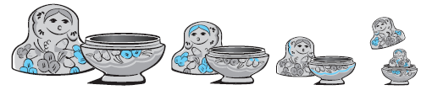
Recursive Thinking
Recursion is a problem-solving approach that can be used to generate simple solutions to certain kinds of problems that are difficult to solve by other means
Recursion reduces a problem into one or more simpler versions of itself

Slide 6
Recursive Thinking (cont.)
Recursive Algorithm to Process Nested Figures
if there is one figure
do whatever is required to the figure
else
do whatever is required to the outer figure
process the figures nested inside the outer figure in the same way

Slide 7
Recursive Thinking (cont.)
Consider searching for a target value in an array
  Assume the array elements are sorted in increasing order
  We compare the target to the middle element and, if the middle element does not match the target, search either the elements before the middle element or the elements after the middle element
  Instead of searching n elements, we search n/2 elements

Slide 8
Recursive Thinking (cont.)
Recursive Algorithm to Search an Array
if the array is empty
return -1 as the search result
else if the middle element matches the target
return the subscript of the middle element as the result
else if the target is less than the middle element
recursively search the array elements preceding the middle element and return the result
else
recursively search the array elements following the middle element and return the result

Slide 9
Steps to Design a Recursive Algorithm
There must be at least one case (the base case), for a small value of n, that can be solved directly
A problem of a given size n can be reduced to one or more smaller versions of the same problem (recursive case(s))
Identify the base case(s) and solve it/them directly
Devise a strategy to reduce the problem to smaller versions of itself while making progress toward the base case
Combine the solutions to the smaller problems to solve the larger problem

Slide 10
Recursive Algorithm for Finding the Length of a String
if the string is empty (has no characters)
the length is 0
else
the length is 1 plus the length of the string that excludes the first character

Slide 11
Recursive Algorithm for Finding the Length of a String (cont.)
/** Recursive method length
@param str The string
@return The length of the string
*/
public static int length(String str) {
if (str == null || str.equals(""))
return 0;
else
return 1 + length(str.substring(1));
}

Slide 12
Recursive Algorithm for Printing String Characters
/** Recursive method printChars
post: The argument string is displayed, one character per line
@param str The string
*/
public static void printChars(String str) {
if (str == null || str.equals(""))
return;
else {
System.out.println(str.charAt(0));
printChars(str.substring(1));
}
}

Slide 13
Recursive Algorithm for Printing String Characters in Reverse
/** Recursive method printCharsReverse
post: The argument string is displayed in reverse, one character per line
@param str The string
*/
public static void printCharsReverse(String str) {
if (str == null || str.equals(""))
return;
else {
printCharsReverse(str.substring(1));
System.out.println(str.charAt(0));
}
}

Slide 14
Proving that a Recursive Method is Correct
Proof by induction
  Prove the theorem is true for the base case
  Show that if the theorem is assumed true for n, then it must be true for n+1
Recursive proof is similar to induction
  Verify the base case is recognized and solved correctly
  Verify that each recursive case makes progress towards the base case
  Verify that if all smaller problems are solved correctly, then the original problem also is solved correctly

Slide 15
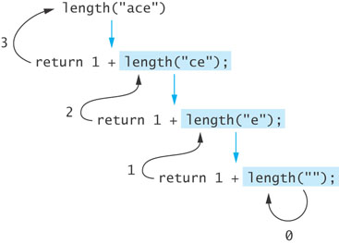
Tracing a Recursive Method
The process of returning from recursive calls and computing the partial results is called unwinding the recursion

Slide 16
Run-Time Stack and Activation Frames
Java maintains a run-time stack on which it saves new information in the form of an activation frame
The activation frame contains storage for
  method arguments
  local variables (if any)
  the return address of the instruction that called the method
Whenever a new method is called (recursive or not), Java pushes a new activation frame onto the run-time stack

Slide 17
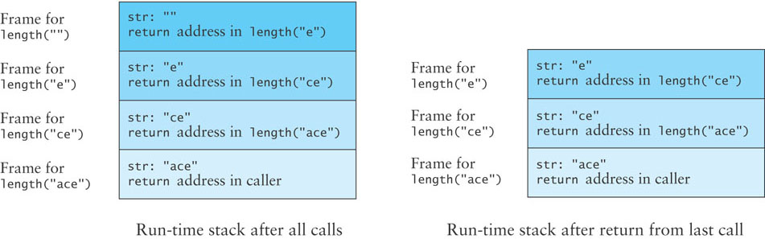
Run-Time Stack and Activation Frames (cont.)

Slide 18
Analogy for the Run-Time Stack for Recursive Calls
An office tower has an employee on each level each with the same list of instructions
  The employee on the bottom level carries out part of the instructions, calls the employee on the next level up and is put on hold
    The employee on the next level completes part of the instructions and calls the employee on the next level up and is put on hold
      The employee on the next level completes part of the instructions and calls the employee on the next level up and is put on hold
        The employee on the next level completes part of the instructions and calls the employee on the next level up and is put on hold, an so on until the top level is reached

Slide 19
Analogy for the Run-Time Stack for Recursive Calls (cont.)
When the employee on the top level finishes the instructions, that employee returns an answer to the employee below
  The employee below resumes, and when finished, returns an answer to the employee below
    The employee below resumes, and when finished, returns an answer to the employee below
      The employee below resumes, and when finished, returns an answer to the employee below, and so on
Eventually the bottom is reached, and all instructions are executed

Slide 20
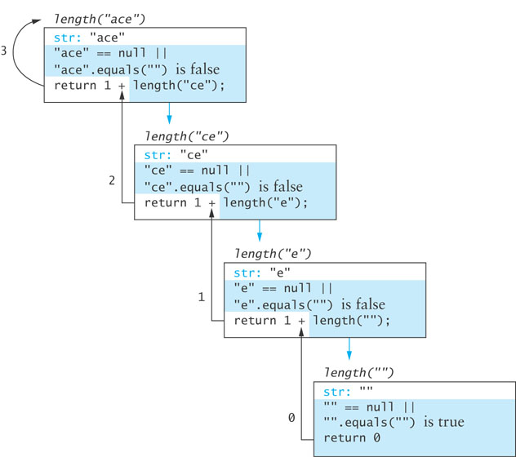
Run-Time Stack and Activation Frames

Slide 21
Recursive Definitions of Mathematical Formulas
Section 5.2

Slide 22
Recursive Definitions of Mathematical Formulas
Mathematicians often use recursive definitions of formulas that lead naturally to recursive algorithms
Examples include:
  factorials
  powers
  greatest common divisors (gcd)

Slide 23
Factorial of n: n!
The factorial of n, or n! is defined as follows:
    0! = 1
    n! = n x (n -1)! (n > 0)
The base case: n is equal to 0
The second formula is a recursive definition

Slide 24
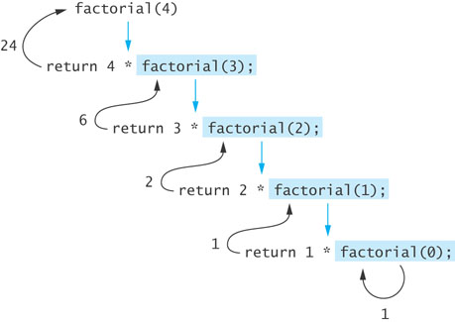
Factorial of n: n! (cont.)
The recursive definition can be expressed by the following algorithm:
    if n equals 0
    n! is 1
    else
    n! = n x (n – 1)!
The last step can be implemented as:
  return n * factorial(n – 1);

Slide 25
Factorial of n: n! (cont.)
public static int factorial(int n) {
if (n == 0)
return 1;
else
return n * factorial(n – 1);
}

Slide 26
Infinite Recursion and Stack Overflow
If you call method factorial with a negative argument, the recursion will not terminate because n will never equal 0
If a program does not terminate, it will eventually throw the StackOverflowError exception
Make sure your recursive methods are constructed so that a stopping case is always reached
In the factorial method, you could throw an IllegalArgumentException if n is negative

Slide 27
Recursive Algorithm for Calculating x^{n}
Recursive Algorithm for Calculating x^{n} (n ≥ 0)
if n is 0
The result is 1
else
The result is x × x^{n–1}
/** Recursive power method (in RecursiveMethods.java).
pre: n >= 0
@param x The number being raised to a power
@param n The exponent
@return x raised to the power n
*/
public static double power(double x, int n) {
if (n == 0)
return 1;
else
return x * power(x, n – 1);
}

Slide 28
Recursive Algorithm for Calculating gcd
The greatest common divisor (gcd) of two numbers is the largest integer that divides both numbers
The gcd of 20 and 15 is 5
The gcd of 36 and 24 is 12
The gcd of 38 and 18 is 2
The gcd of 17 and 97 is 1

Slide 29
Recursive Algorithm for Calculating gcd (cont.)
Given 2 positive integers m and n (m > n)
if n is a divisor of m
gcd(m, n) = n
else
gcd (m, n) = gcd (n, m % n)

Slide 30
Recursive Algorithm for Calculating gcd (cont.)
/** Recursive gcd method (in RecursiveMethods.java).
pre: m > 0 and n > 0
@param m The larger number
@param n The smaller number
@return Greatest common divisor of m and n
*/
public static double gcd(int m, int n) {
if (m % n == 0)
return n;
else
return gcd(n, m % n);
}

Slide 31
Recursion Versus Iteration
There are similarities between recursion and iteration
In iteration, a loop repetition condition determines whether to repeat the loop body or exit from the loop
In recursion, the condition usually tests for a base case
You can always write an iterative solution to a problem that is solvable by recursion
A recursive algorithm may be simpler than an iterative algorithm and thus easier to write, code, debug, and read

Slide 32
Iterative factorial Method
/** Iterative factorial method.
pre: n >= 0
@param n The integer whose factorial is being computed
@return n!
*/
public static int factorialIter(int n) {
int result = 1;
for (int k = 1; k <= n; k++)
result = result * k;
return result;
}

Slide 33
Efficiency of Recursion
Recursive methods often have slower execution times relative to their iterative counterparts
The overhead for loop repetition is smaller than the overhead for a method call and return
If it is easier to conceptualize an algorithm using recursion, then you should code it as a recursive method
The reduction in efficiency usually does not outweigh the advantage of readable code that is easy to debug

Slide 34
Fibonacci Numbers
Fibonacci numbers were used to model the growth of a rabbit colony
fib₁ = 1
fib₂ = 1
fib_{n} = fib_{n-1} + fib_{n-2}
1, 1, 2, 3, 5, 8, 13, 21, 34, 55, 89, 144, …

Slide 35

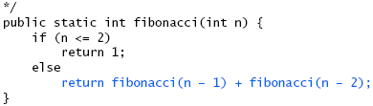
An Exponential Recursive fibonacci Method

Slide 36
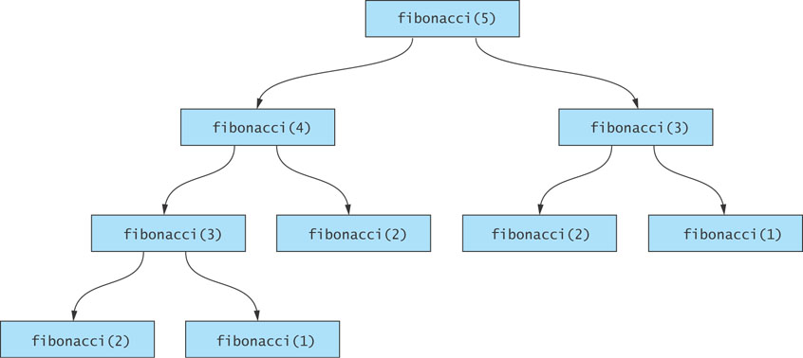
Efficiency of Recursion: Exponential fibonacci
Inefficient

Slide 37
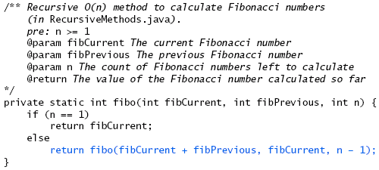
An O(n) Recursive fibonacci Method

Slide 38
An O(n) Recursive fibonacci Method (cont.)
In order to start the method executing, we provide a non-recursive wrapper method:
/** Wrapper method for calculating Fibonacci numbers (in RecursiveMethods.java).
pre: n >= 1
@param n The position of the desired Fibonacci number
@return The value of the nth Fibonacci number
*/
public static int fibonacciStart(int n) {
return fibo(1, 0, n);
}

Slide 39
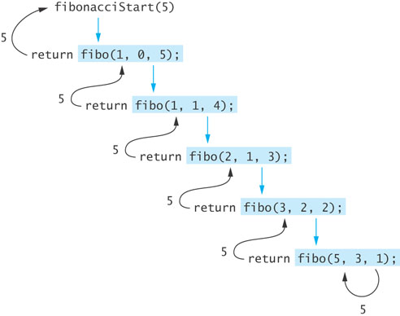
Efficiency of Recursion: O(n) fibonacci
Efficient

Slide 40
Recursive Array Search
Section 5.3

Slide 41
Recursive Array Search
Searching an array can be accomplished using recursion
Simplest way to search is a linear search
  Examine one element at a time starting with the first element and ending with the last
  On average, (n + 1)/2 elements are examined to find the target in a linear search
  If the target is not in the list, n elements are examined
A linear search is O(n)

Slide 42
Recursive Array Search (cont.)
Base cases for recursive search:
  Empty array, target can not be found; result is -1
  First element of the array being searched = target; result is the subscript of first element
The recursive step searches the rest of the array, excluding the first element

Slide 43
Algorithm for Recursive Linear Array Search
Algorithm for Recursive Linear Array Search
if the array is empty
the result is –1
else if the first element matches the target
the result is the subscript of the first element
else
search the array excluding the first element and return the result

Slide 44
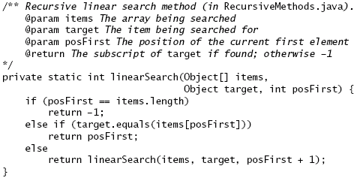
Implementation of Recursive Linear Search

Slide 45
Implementation of Recursive Linear Search (cont.)
A non-recursive wrapper method:
/** Wrapper for recursive linear search method
@param items The array being searched
@param target The object being searched for
@return The subscript of target if found;
otherwise -1
*/
public static int linearSearch(Object[] items, Object target) {
return linearSearch(items, target, 0);
}

Slide 46
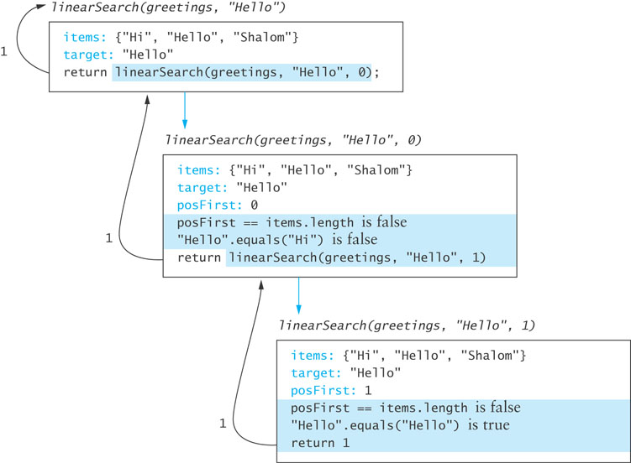
Implementation of Recursive Linear Search (cont.)

Slide 47
Design of a Binary Search Algorithm
A binary search can be performed only on an array that has been sorted
Base cases
  The array is empty
  Element being examined matches the target
Rather than looking at the first element, a binary search compares the middle element for a match with the target
If the middle element does not match the target, a binary search excludes the half of the array within which the target cannot lie

Slide 48
Design of a Binary Search Algorithm (cont.)
Binary Search Algorithm
if the array is empty
return –1 as the search result
else if the middle element matches the target
return the subscript of the middle element as the result
else if the target is less than the middle element
recursively search the array elements before the middle element
and return the result
else
recursively search the array elements after the middle element and
return the result

Slide 49
Binary Search Algorithm
target
First call
Dustin
Caryn
Debbie
Dustin
Elliot
Jacquie
Jonathon
Rich
first = 0
middle = 3
last = 6

Slide 50
Binary Search Algorithm (cont.)
target
Second call
Dustin
Caryn
Debbie
Dustin
Elliot
Jacquie
Jonathon
Rich
first = 0
last = 2
middle = 1

Slide 51
Binary Search Algorithm (cont.)
target
Third call
Dustin
Caryn
Debbie
Dustin
Elliot
Jacquie
Jonathon
Rich
first= middle = last = 2

Slide 52
Efficiency of Binary Search
At each recursive call we eliminate half the array elements from consideration, making a binary search O(log n)
An array of 16 would search arrays of length 16, 8, 4, 2, and 1: 5 probes in the worst case
  16 = 2⁴
  5 = log₂16 + 1
A doubled array size would require only 6 probes in the worst case
  32 = 2⁵
  6 = log₂32 + 1
An array with 32,768 elements requires only 16 probes! (log₂32768 = 15)

Slide 53
Comparable Interface
Classes that implement the Comparable interface must define a compareTo method
Method call obj1.compareTo(obj2) returns an integer with the following values
  negative if obj1 < obj2
  zero if obj1 == obj2
  positive if obj1 > obj2
Implementing the Comparable interface is an efficient way to compare objects during a search

Slide 54
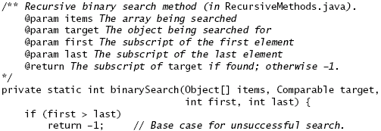
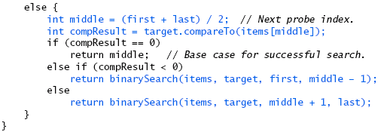
Implementation of a Binary Search Algorithm

Slide 55
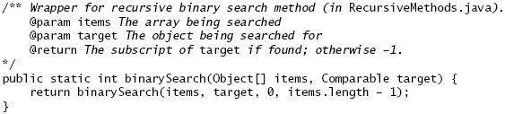
Implementation of a Binary Search Algorithm (cont.)

Slide 56
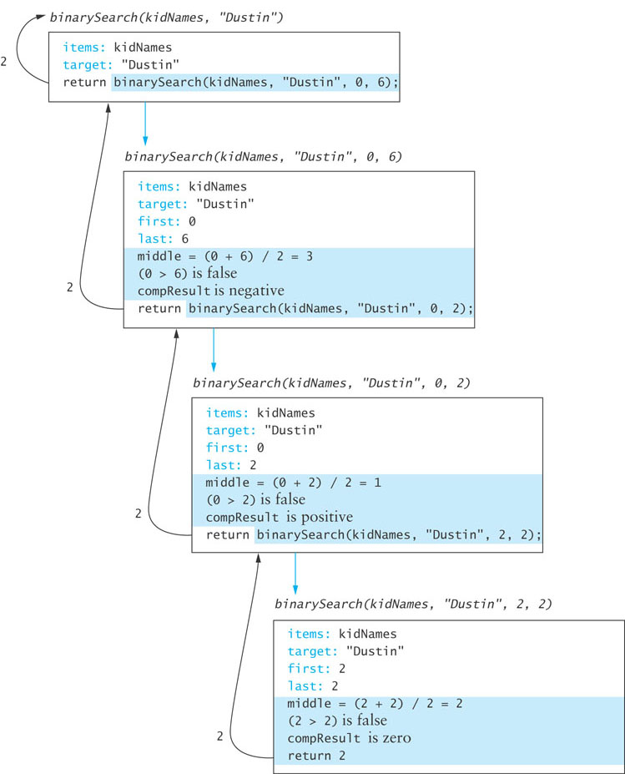
Trace of Binary Search

Slide 57
Testing Binary Search
You should test arrays with
  an even number of elements
  an odd number of elements
  duplicate elements
Test each array for the following cases:
  the target is the element at each position of the array, starting with the first position and ending with the last position
  the target is less than the smallest array element
  the target is greater than the largest array element
  the target is a value between each pair of items in the array

Slide 58
Method Arrays.binarySearch
Java API class Arrays contains a binarySearch method
  Called with sorted arrays of primitive types or with sorted arrays of objects
  If the objects in the array are not mutually comparable or if the array is not sorted, the results are undefined
  If there are multiple copies of the target value in the array, there is no guarantee which one will be found
  Throws ClassCastException if the target is not comparable to the array elements

Slide 59
Recursive Data Structures
Section 5.4

Slide 60
Recursive Data Structures
Computer scientists often encounter data structures that are defined recursively – each with another version of itself as a component
Linked lists and trees (Chapter 6) can be defined as recursive data structures
Recursive methods provide a natural mechanism for processing recursive data structures
The first language developed for artificial intelligence research was a recursive language called LISP

Slide 61
Recursive Definition of a Linked List
A linked list is a collection of nodes such that each node references another linked list consisting of the nodes that follow it in the list
The last node references an empty list
A linked list is empty, or it contains a node, called the list head, that stores data and a reference to a linked list

Slide 62
Class LinkedListRec
We define a class LinkedListRec<E> that implements several list operations using recursive methods
public class LinkedListRec<E> {
private Node<E> head;
// inner class Node<E> here
// (from chapter 2)
}

Slide 63
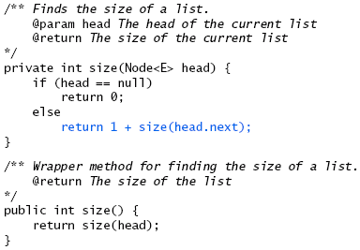
Recursive size Method

Slide 64
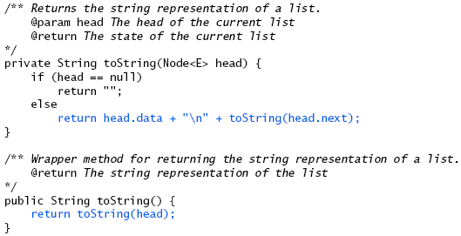
Recursive toString Method

Slide 65
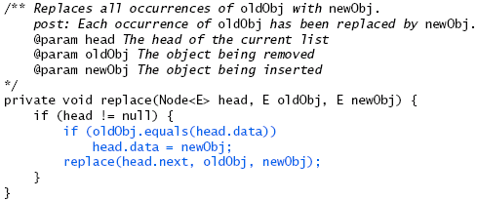
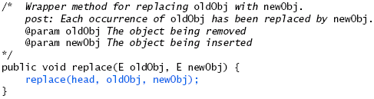
Recursive replace Method

Slide 66
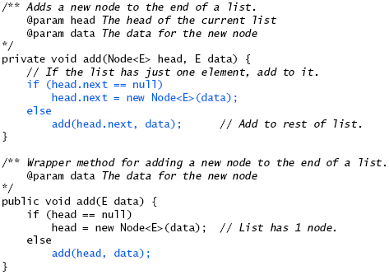
Recursive add Method

Slide 67
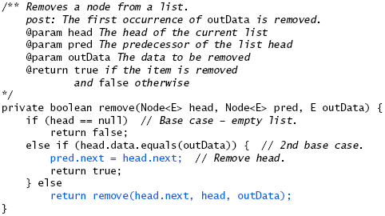
Recursive remove Method

Slide 68
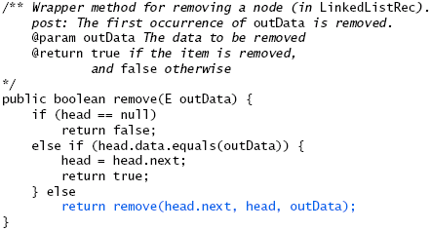
Recursive remove Method (cont.)

Slide 69
Problem Solving with Recursion
Section 5.5

Slide 70
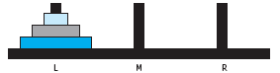
Simplified Towers of Hanoi
Move the three disks to a different peg, maintaining their order (largest disk on bottom, smallest on top, etc.)
  Only the top disk on a peg can be moved to another peg
  A larger disk cannot be placed on top of a smaller disk

Slide 71
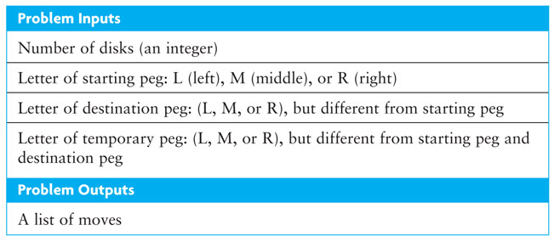
Towers of Hanoi

Slide 72
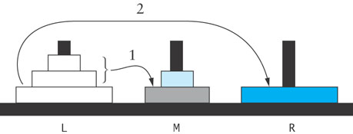
Algorithm for Towers of Hanoi
Solution to Three-Disk Problem: Move Three Disks from Peg L to Peg R
1. Move the top two disks from peg L to peg M.
2. Move the bottom disk from peg L to peg R.
3. Move the top two disks from peg M to peg R.

Slide 73
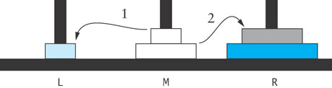
Algorithm for Towers of Hanoi (cont.)
Solution to Three-Disk Problem: Move Top Two Disks from Peg M to Peg R
1. Move the top disk from peg M to peg L.
2. Move the bottom disk from peg M to peg R.
3. Move the top disk from peg L to peg R.

Slide 74
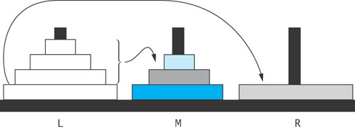
Algorithm for Towers of Hanoi (cont.)
Solution to Four-Disk Problem: Move Four Disks from Peg L to Peg R
1. Move the top three disks from peg L to peg M.
2. Move the bottom disk from peg L to peg R.
3. Move the top three disks from peg M to peg R.

Slide 75
Recursive Algorithm for Towers of Hanoi
Recursive Algorithm for n -Disk Problem: Move n Disks from the Starting Peg to the Destination Peg
if n is 1
move disk 1 (the smallest disk) from the starting peg to the destination
peg
else
move the top n – 1 disks from the starting peg to the temporary peg
(neither starting nor destination peg)
move disk n (the disk at the bottom) from the starting peg to the
destination peg
move the top n – 1 disks from the temporary peg to the destination peg

Slide 76
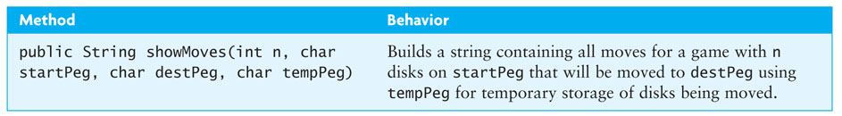
Recursive Algorithm for Towers of Hanoi (cont.)

Slide 77
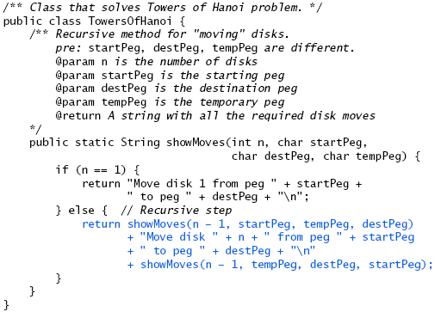
Implementation of Recursive Towers of Hanoi

Slide 78
Counting Cells in a Blob
Consider how we might process an image that is presented as a two-dimensional array of color values
Information in the image may come from
  an X-ray
  an MRI
  satellite imagery
  etc.
The goal is to determine the size of any area in the image that is considered abnormal because of its color values

Slide 79
Counting Cells in a Blob – the Problem
Given a two-dimensional grid of cells, each cell contains either a normal background color or a second color, which indicates the presence of an abnormality
A blob is a collection of contiguous abnormal cells
A user will enter the x, y coordinates of a cell in the blob, and the program will determine the count of all cells in that blob

Slide 80
Counting Cells in a Blob - Analysis
Problem Inputs
  the two-dimensional grid of cells
  the coordinates of a cell in a blob
Problem Outputs
  the count of cells in the blob

Slide 81
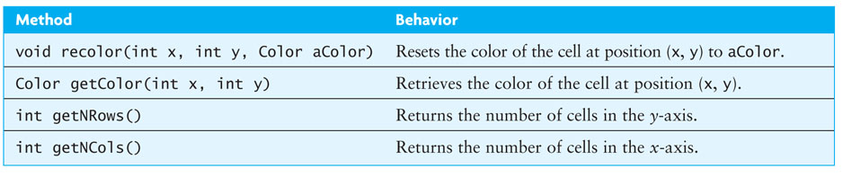
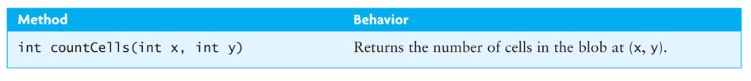
Counting Cells in a Blob - Design

Slide 82
Counting Cells in a Blob - Design (cont.)
Algorithm for countCells(x, y)
if the cell at (x, y) is outside the grid
the result is 0
else if the color of the cell at(x, y)is not the abnormal color
the result is 0
else
set the color of the cell at(x, y)to a temporary color
the result is 1 plus the number of cells in each piece of the blob that
includes a nearest neighbor

Slide 83
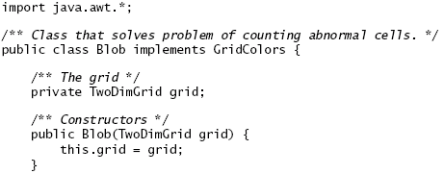
Counting Cells in a Blob - Implementation

Slide 84
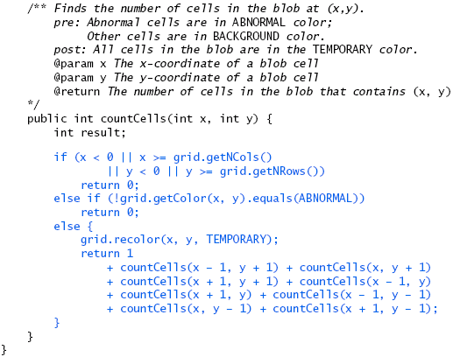
Counting Cells in a Blob - Implementation (cont.)

Slide 85
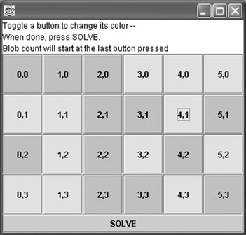
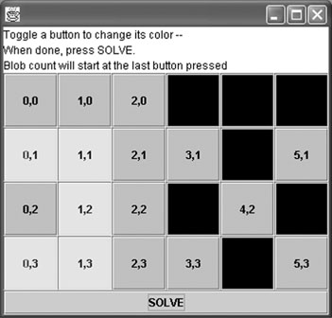
Counting Cells in a Blob -Testing

Slide 86
Counting Cells in a Blob -Testing (cont.)
Verify that the code works for the following cases:
  A starting cell that is on the edge of the grid
  A starting cell that has no neighboring abnormal cells
  A starting cell whose only abnormal neighbor cells are diagonally connected to it
  A "bull's-eye": a starting cell whose neighbors are all normal but their neighbors are abnormal
  A starting cell that is normal
  A grid that contains all abnormal cells
  A grid that contains all normal cells

Slide 87
Backtracking
Section 5.6

Slide 88
Backtracking
Backtracking is an approach to implementing a systematic trial and error search for a solution
An example is finding a path through a maze
If you are attempting to walk through a maze, you will probably walk down a path as far as you can go
  Eventually, you will reach your destination or you won’t be able to go any farther
  If you can’t go any farther, you will need to consider alternative paths
Backtracking is a systematic, nonrepetitive approach to trying alternative paths and eliminating them if they don’t work

Slide 89
Backtracking (cont.)
If you never try the same path more than once, you will eventually find a solution path if one exists
Problems that are solved by backtracking can be described as a set of choices made by some method
Recursion allows you to implement backtracking in a relatively straightforward manner
  Each activation frame is used to remember the choice that was made at that particular decision point
A program that plays chess may involve some kind of backtracking algorithm

Slide 90
Finding a Path through a Maze
Problem
  Use backtracking to find a display the path through a maze
  From each point in a maze you can move to the next cell in a horizontal or vertical direction if the cell is not blocked

Slide 91
Finding a Path through a Maze (cont.)
Analysis
  The maze will consist of a grid of colored cells
  The starting point is at the top left corner (0,0)
  The exit point is at the bottom right corner (getNCols() – 1, getNRow -1)
  All cells on the path will be BACKGROUND color
  All cells that represent barriers will be ABNORMAL color
  Cells that we have visited will be TEMPORARY color
  If we find a path, all cells on the path will be set to PATH color

Slide 92
Recursive Algorithm for Finding Maze Path
Recursive Algorithm for findMazePath(x, y)
if the current cell is outside the maze
return false (you are out of bounds)
else if the current cell is part of the barrier or has been visited already
return false (you are off the path or in a cycle)
else if the current cell is the maze exit
recolor it to the path color and return true (you have successfully
completed the maze)
else // Try to find a path from the current path to the exit:
mark the current cell as on the path by recoloring it to the path color
for each neighbor of the current cell
if a path exists from the neighbor to the maze exit
return true
// No neighbor of the current cell is on the path
recolor the current cell to the temporary color (visited) and return
false

Slide 93
Implementation
Listing 5.4 (Maze.java, pages 286-287)

Slide 94
Testing
Test for a variety of test cases:
  Mazes that can be solved
  Mazes that can't be solved
  A maze with no barrier cells
  A maze with a single barrier cell at the exit point

